Slide 1
28 June 2021
Joint Briefing
Public Hearings:
Inquiry into Ensuring Free and Fair Local Government Elections during COVID-19 led by Justice Moseneke

Slide 2
Introduction
Preliminary points:
PHM and HJI’s joint submission should not in any way be construed as support for or against the hosting of local government elections in October 2021.
We believe that whether to proceed or not must be a decision of government and all political parties, based on expert input and advice, and subject (where applicable) to review by our courts because of the highly contentious and political nature of the issue at hand, in a pandemic.
If we are unable to hold a safe set of elections including safe campaigning, it will create mistrust in elections and any outcome.
We are operating in a context of imperfect knowledge and science, with multiple variants and outbreaks of Covid-19, across the globe.
We have limited vaccine supplies which prevents immediate mass vaccination of the majority of people living here.
Limited vaccine supply and other constraints mean that some age and profession cohorts are being prioritised (HCWs, front line staff, over 60year old's) and that it may take months before everyone who is eligible, is vaccinated in South Africa and the region, if not years.
This means that many eligible voters may not be fully vaccinated in time for the elections (vaccine selection means some people require two doses 41 days apart).
Even in countries with available and sufficient supplies, it takes several months before population coverage reaches even 50%. US and UK are examples: both started vaccination programme by December 2020 / January 2021 and by June 2021 have managed to reach 45.3% and 47.3% coverage respectively.
https://ourworldindata.org/grapher/share-people-fully-vaccinated-covid?country=CAN~GBR~USA

Slide 3
Positive test results globally *24 June

Slide 4
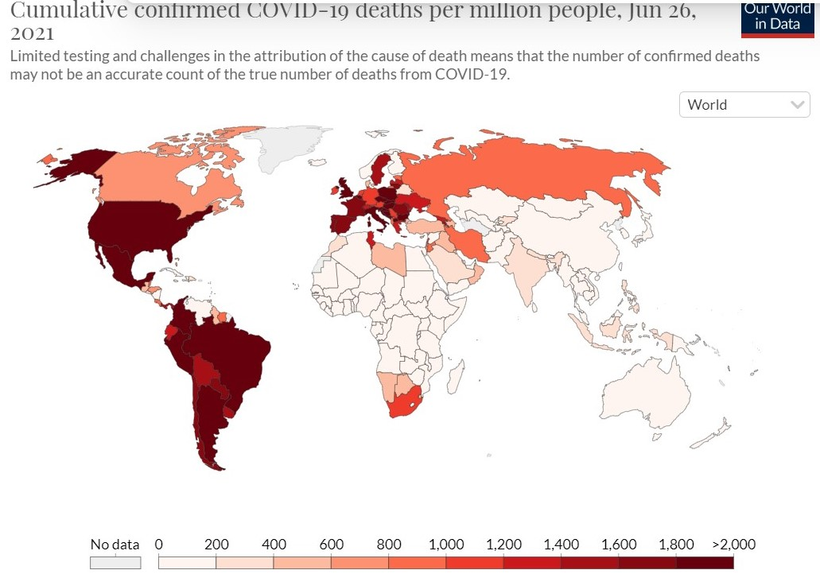
Deaths globally *26 June

Slide 5
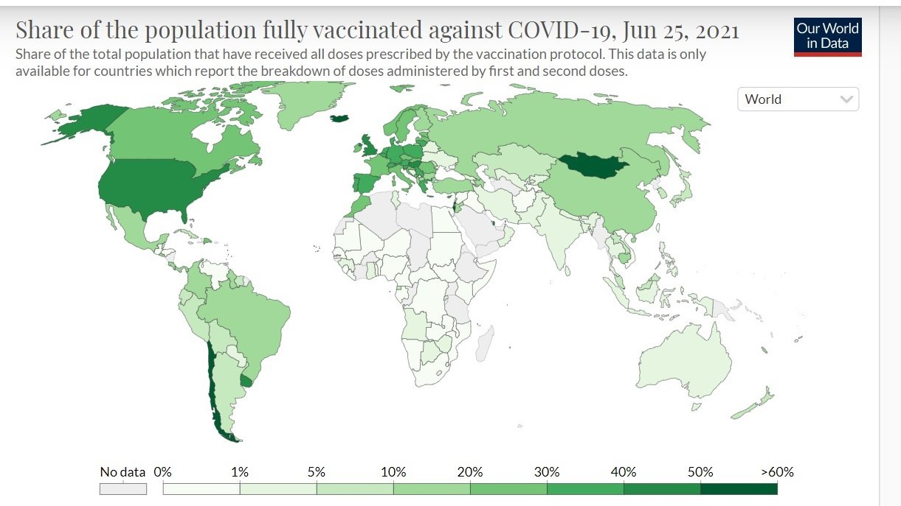
Global Context of Vaccination *25 June
22.6% of the world population has received at least one dose of a COVID-19 vaccine. 2.8 billion doses have been administered globally, and 41.2 million are now administered each day. Only 0.9% of people in low-income countries have received at least one dose.

Slide 6
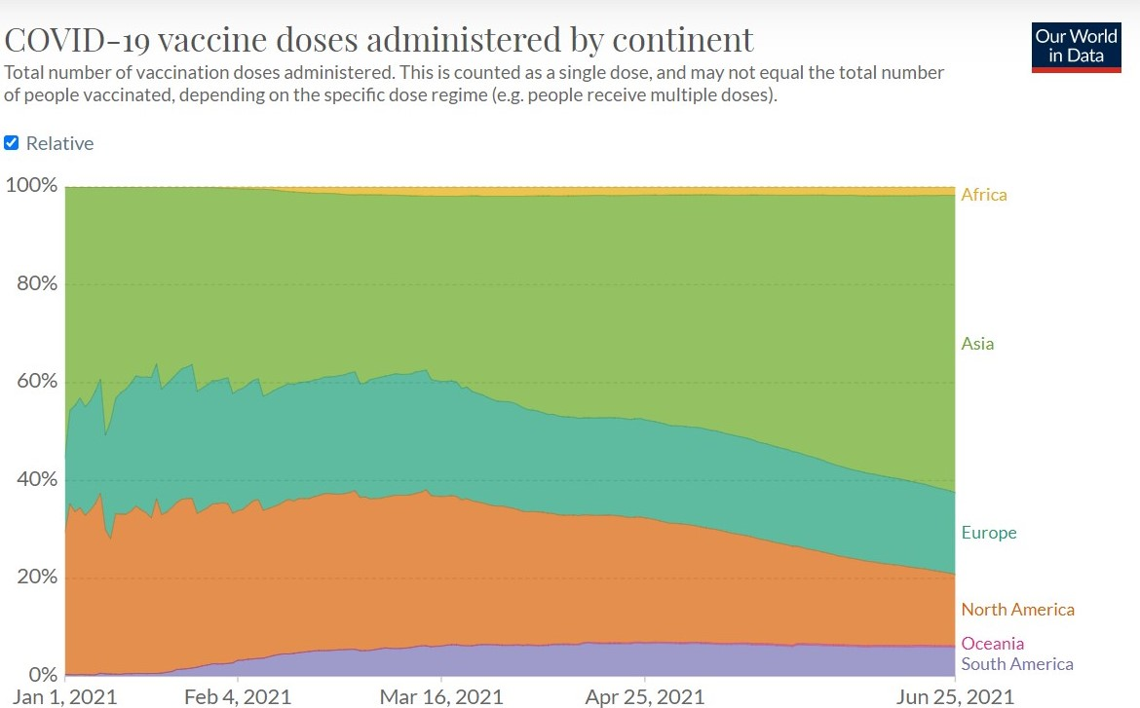
COVID-19 vaccine doses administered by continent
This is counted as a single dose and may not equal the total number of people vaccinated, depending on the specific dose regimen.

Slide 7
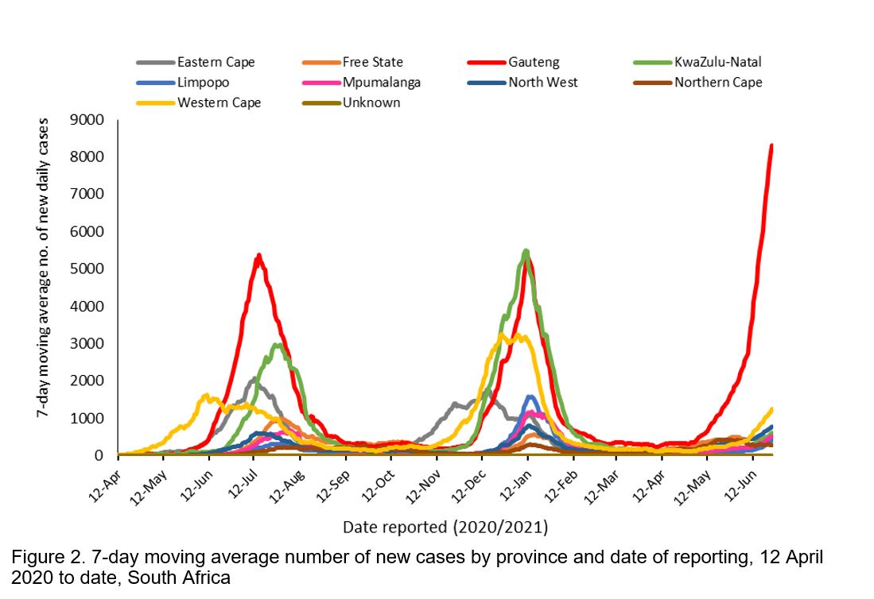
Local Context – Cases *26 June
https://www.nicd.ac.za/latest-confirmed-cases-of-covid-19-in-south-africa-26-june-2021/

Slide 8
Local Context – Vaccination Coverage *26 June
https://sacoronavirus.co.za/latest-vaccine-statistics/

Slide 9
Notes on SA Vaccination Programme
It is slow. It is affected by global supply chains and global and local regulatory issues too.
While government anticipates increasing the current rate of vaccinations, even if this is achieved, it would take well into 2022 for South Africa to achieve “population immunity” from COVID-19 infection through vaccination.
South Africa is using two vaccines for people over 60 years, school support staff, correctional services staff and inmates, and soon pilot workplaces.
Government has announced that in July people over 50 years can start registering with possible vaccination to start late July, depending on supply chains.
Notes:
There has been a statement that over 50s will be eligible from mid July

Slide 10
Variants in South Africa *26 June
South Africa is currently entering into its 3rd wave of COVID-19 infections and at Level 4 as of today.
The first wave of COVID-19 peaked in the week starting 13 July 2020 (epi week 29 of 2020), the second wave in the week of 11 January 2021 (epi week 2of 2021).
While we cannot, with certainty, predict the trajectory of the pandemic going forward, it looks likely that the 3rd wave will have its peak within the next 3 to 5 weeks.
In other words, the 25-week gap between peaks of the 1st and 2nd waves will be replicated between the 2nd and 3rd waves.
Concerning variants of SARS-CoV-2 continue to evolve, including the so-called ‘delta’ variant that is judged to be even more transmissible than the variant (beta) and, according to scientists from UKZN, is a major factor behind the 3rd wave in SA
Each wave of COVID-19 in SA has been driven by a different variant of SARS-CoV-2 and in the context of high global transmission, the virus keeps evolving. South Africa risks a fourth wave of COVID-19 in the fourth quarter of 2021. Increase in gatherings, especially those conducted indoors in venues with poor ventilation, increases the risk of this scenario.

Slide 11
We cannot predict, but it is risky right now
We do not know the impact of current vaccines & vaccination on most circulating variants.
Precautionary principle: we know too little about variants including beta, delta & its impact on vaccines and vaccination.
Our sequencing surveillance takes on average 30-60 days to deliver results.
Our sampling is inadequate and our testing largely passive (driven by presentation at health facility).
WHO Director General – Dr Tedros Adhanom Ghebreyesus (18 June 2021)
‘And yet even after 18 months, the ineffective use of public health and social measures, increased social mixing and vaccine inequity continue to give COVID-19 an opportunity to mutate, spread and kill.
The global failure to share vaccines equitably is fuelling a two-track pandemic that is now taking its toll on some of the world’s poorest and most vulnerable people.
Every region has countries that are now facing a steep increase in cases and deaths.
Many countries in Latin America have rapidly increasing epidemics, and others have plateaued at a high level. In Africa, cases have increased by 52% just in the past week, and deaths have increased by 32%. And we expect things to only get worse.’
https://www.who.int/director-general/speeches/detail/who-director-general-s-opening-remarks-at-the-media-briefing-on-covid-19-18-june-2021
Notes:
https://businesstech.co.za/news/government/501397/highly-infectious-delta-covid-variant-is-ripping-through-south-africa-health-department/

Slide 12
How to hold safe(r)Elections in a pandemic?
We do not know nor can predict with accuracy when lock down levels will be escalated or dropped, based on past year’s experience.
Campaigning likely to be affected with restrictions on movement, and curfews.
RISK: if no political will to enforce any restrictions on gatherings could result in super-spreader events.
With multiple communities facing death and illness, we may have fewer people willing to leave home unless they must (for work, for seeking urgent health care, necessities) potentially resulting in an even lower electoral turn out. (cite studies showing interruption even of ARV and TB )
Risk communication with regards to COVID-19 in South Africa has been poor throughout the pandemic.
Existing regulations with regards to limiting numbers in gatherings, physical distancing and the wearing of masks can serve to reduce the risks of election activities, especially if these activities are conducted outdoors.
But, campaigning can contain elements of close interaction, for example door-to-door visits and ‘voter registration tables’.
Some political parties have themselves been implicated in spreading misinformation– will they then be fined or suspended from participating in the elections given the laws currently applicable to COVID disinformation (fake news).

Slide 13
If Elections proceed…
Voting process, is controllable but remains risky:
Messaging of ’stay at home’ v messaging of ‘come out to vote’ or ‘come to x rally’ – will create contested and confusing messaging for some communities and potential to harm public health measures (many communities cannot join a zoom rally, nor do we have mail balloting in SA).
Long queues require social distancing and marshalling (likelihood of fear of being marshalled by police/army due to repressive control techniques used, albeit uneven).
Limited number and location (open air) of voting sites, is likely to result in congestion of people/officials
Limited outdoor, properly ventilated, voting sites with NPI’s in place (spraying and temperature checks not sufficient).
Everyone at same ballot booths requiring sanitising after every vote cast which will lengthen voting process unless alternatives are secured (potential for high risk in handling of the same ballot materials).
IEC officials handling multiple voters documents for verification.
IEC officials and party monitors: result counting and verification will require social distancing, ventilation, non-API interventions and PPE.
Notes:
Can’t see it possible to rely on open air sites

Slide 14
Further consultation and trust building
Projected trajectory is hard to predict with certainty because imperfect knowledge is available.
We recommend:
Consulting with the African CDC and WHO given the potential risk for the region; best practices used in other jurisdictions.
Emphasising risk communication campaigns and specific measures to reduce transmission and misinformation for both electioneering and voting.
Specific measures and penalties should be put in place to ensure that all political parties comply with measures aimed to reduce COVID-19 transmission and do not spread misinformation.
The IEC guidelines should be clearer on the need for open air and properly ventilated voting stations and should include more specific measures to guide procedures that would need to be implemented in the case of COVID-19 exposure.

Slide 15
Useful links
Statistics:
https://ourworldindata.org/coronavirus
https://sacoronavirus.co.za/latest-vaccine-statistics/
https://www.nicd.ac.za/latest-confirmed-cases-of-covid-19-in-south-africa-26-june-2021/
Articles and Speeches:
https://www.who.int/director-general/speeches/detail/who-director-general-s-opening-remarks-at-the-media-briefing-on-covid-19-18-june-2021
https://www.spotlightnsp.co.za/2020/03/20/covid-19-we-need-both-physical-distancing-and-social-solidarity/
https://aidc.org.za/the-coronavirus-crisis-and-the-struggle-for-health/
https://www.reuters.com/world/asia-pacific/exclusive-scientists-say-india-government-ignored-warnings-amid-coronavirus-2021-05-01/
https://www.hindustantimes.com/india-news/madras-high-court-blames-election-commission-for-surge-in-covid-cases-101619488095052.html
https://thewire.in/politics/election-rally-covid-19-case-spike
https://www.aljazeera.com/news/2018/12/27/protesters-in-drcs-beni-target-ebola-centre-over-election-delay
https://www.dailymaverick.co.za/article/2020-12-06-the-great-covid-19-vaccine-heist/
https://healthjusticeinitiative.org.za/vaccine-equity/vaccine-timeline/

